Slide 1


21. & 22. Juni 2022
Satelliten-Workshop
Block 3 – Technology Components
Martin Mailand

Slide 2
Agenda
20 Min. - CampusOS Project - Intro & Approach
10 Min. – CampusDynA
10 Min. – MAVERIC
10 Min. – TICCTEC
10 Min. - 5G++FlexiCell
10 Min. - KliNet5G
10 Min. - O5G-N-IoT
60 Min – Discussion (probably in subgroups)
10 Min. - Wrap-Up & Next Steps

Slide 3
Key Question & Expected Outcome I
Technology Components
Which technology components/products will be developed or made available and when?
Establish for each project an understanding with respect to the following aspects:
What kind of installations are possible/needed? E.g.
How many antennas, carrier frequency (<6 GHz, >28 GHz)
How many nodes are interconnected, depends then on radio infrastructure.
Which kind of KPIs we are interested in
Mobility, latency, interconnection, high throughput nodes, connectivity
What is the stated demand
What kind of UEs/devices focused
Key functionality a RIC should handle
Near-RT or non-RT
placement of functions

Slide 4
Key Question & Expected Outcome II
Technology Components
Establish for each project an understanding with respect to the following aspects:
Use case as an entry point
Figure out requirements/expectations
Assess what products are already available in market.
Flexibility
It isn’t generally flexible in industry. Because their challenges lie in addressing use cases, rather than radio infrastructure.
We should go beyond the existing ecosystem and find flexible systems.
Who is developing new features in OpenRAN ecosystem
Expectations from workshop, e.g.
Use 5G, where should I go
Definition of use case from satellites

Slide 5
MAVERIC
<Long_Project_Name>
<Key contact project coordinator (Name & e-mail)>
<Key contact “block 4” topics (e.g. task lead; Name & e-mail)>

Slide 6
MAVERIC
Installation PoC - NVL
Two outdoor RUs
Two to four indoor RUs for one dock
All of the RUs are sub 6GHz with 100MHz bandwidth
Different RAN systems will be tested, each system for 2-3 weeks
Two C-RAN systems with a Single Frequency Network (SFN) for the indoor RUs
One O-RAN system

Slide 7
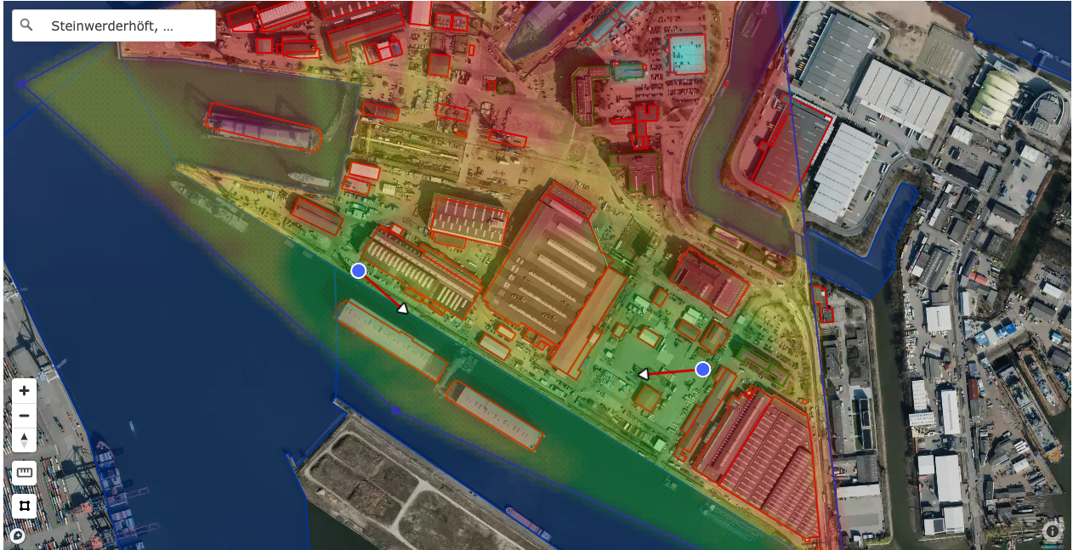
MAVERIC
Installation PoC - NVL

Slide 8
MAVERIC
KPIs
Latency
Throughput
Connectivity
Energy consumption
Need to develop sensors which will be deployed on-site to test the KPI every one to five minute

Slide 9
MAVERIC
UEs
COTS UEs for voice and video calls
COTS pads for mobile data to receive digital plans
Future use cases could be
Augmented reality to help in the construction work
Autonomous delivery of work material to the dock

Slide 10
MAVERIC
RIC
Near-RT RIC
Self Organizing Network functionality
Cell-Id management
Interference coordination
Non-RT RIC
Placement of edge resources

Slide 11
Potential collaborations
Things to discuss:
KPI measurement and reporting
Self Organizing Networks regarding the O-RAN concept
Please add here bullets regarding potential collaboration that you would like to discuss. If you do not have specific points so far, it is ok to leave this slide empty. We will combine all bullets into one slide for a joint discussion

Slide 12
Wrap-Up & Next Steps
Not to required to be filled out by each satellite project. Just a placeholder to give an idea on potential wrap up topics
Potential aspects to consider:
Collaborations
Equipment exchange
Connection of people and awareness.
Should give a feeling there are many options for a use case provider.
RAN type? OpenRAN or SDR
Efficiency?
What evolved ecosystem of components fits into addressing the satellite partner’s use cases. CampusOS could suggest recommended blocks.

